Slide 1


Slide 2

25
Years of experience Creating better energy and climate future

Slide 3
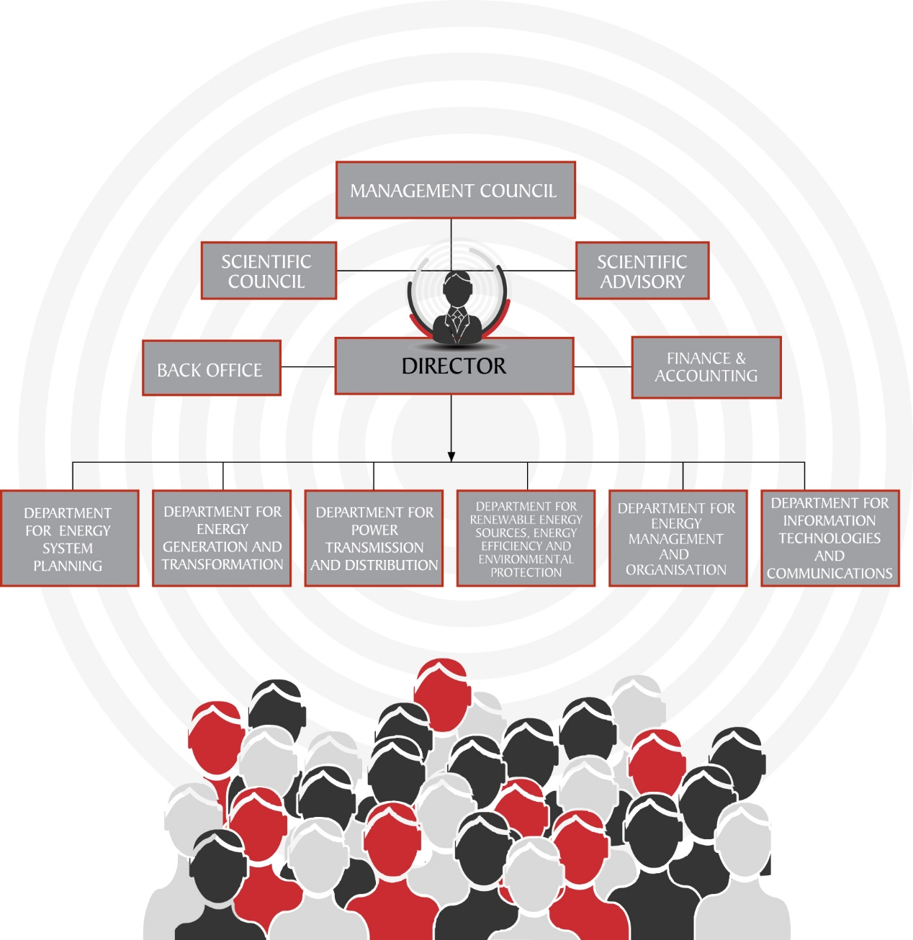
EIHP ORGANISATIONAL SCHEME
85 Employees
21 PhDs

Slide 4



OUR GOAL
To be recognised as a centre of excellence in the field of energy planning, analysis, and environmental protection, locally and internationally.

Slide 5
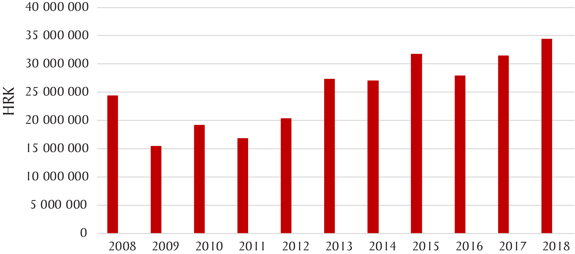
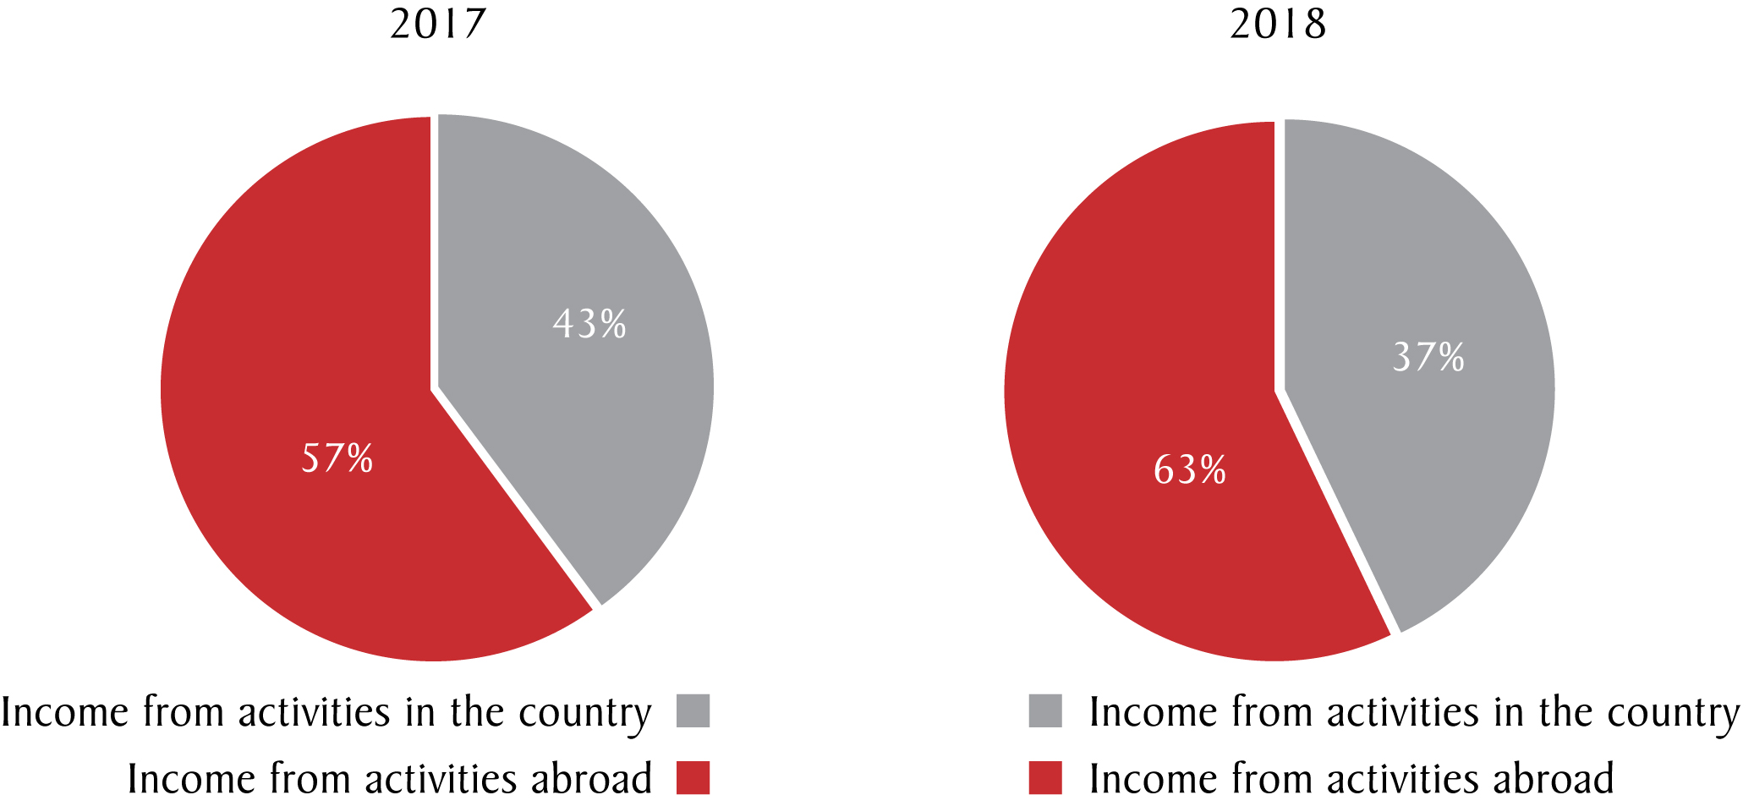
EIHP INCOME

Slide 6
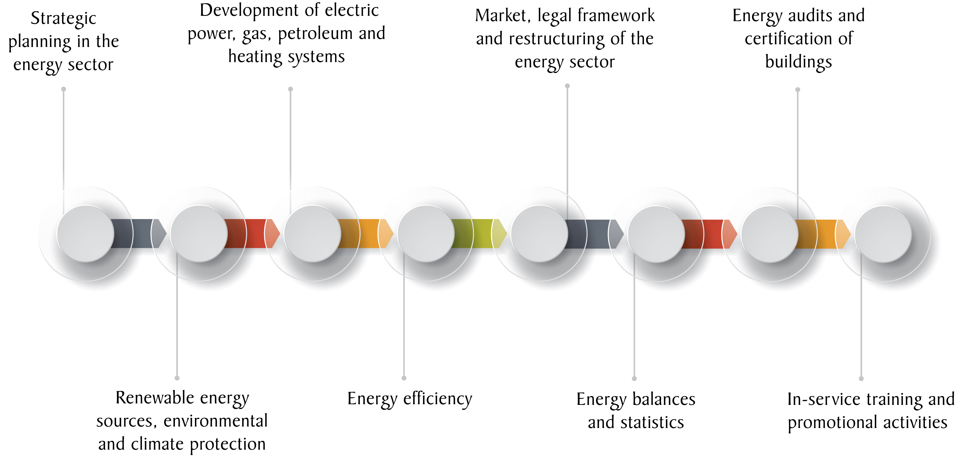
THE INSTITUTE’S AREAS OF ACTIVITY

Slide 7
STRATEGIC PLANNING IN THE ENERGY SECTOR
Development of national, regional and local energy strategies, action plans, and related programmes in accordance with relevant directives and regulations
Technical support to energy companies in the planning and development of their businesses and energy sector

Slide 8
DEVELOPMENT OF POWER, GAS, PETROLEUM, AND HEATING SYSTEMS
Drafting of energy networks development plans
Drafting of energy system master plans
Feasibility studies for the construction of power plants
Operation optimisation of energy systems or their segments
Calculation of potential power plant output
Analysis of energy supply quality
Analysis of energy system safety and reliability
Technical and economic impact analysis for the installation of various equipment in energy systems
Conducting surveys and studies on connecting renewable energy plants, other production plants, and consumers to the power supply network

Slide 9
MARKET ANALYSIS, LEGAL FRAMEWORK, AND RESTRUCTURING OF ENERGY SECTOR
Analysis of energy companies market potential
Benchmarking analysis of system operators and statistics of operational events
Preparation of bases for the calculation of energy networks utilisation fees
Provision of expert opinions in lawsuits
Tariff policy and tariff methodologies
Drafting of legislation and supporting documentation
Restructuring, organisation, and refinancing strategies for energy companies

Slide 10
ENERGY BALANCES AND STATISTICS
Data collection and compilation of energy statistics and energy balances for the Republic of Croatia, as well as for its counties, municipalities, towns, and islands
Reporting official energy statistics and energy balances to international organisations
Conducting opinion polls on energy consumption, consumer behaviour, and attitudes towards new energy solutions
Calculation of various energy indicators for monitoring, validation, and verification of energy policies, and related measures
Establishment of energy information system and platform for demand forecasting and energy supply option analysis
Development of energy atlas and graphical presentation of data on maps

Slide 11
RENEWABLE ENERGY SOURCES
Research and assessment of the energy potential of renewable energy sources
Measurement of available resources, bankable studies of a potential for the commercial sector
RES plant site selection and evaluation
Consulting on the choice of technology and design solution for the planned power plants
Market analyses and research, assessments and forecasts for public and commercial sectors
Project due diligence before financial closing or in the process of take-over; sell-side and buy-side consulting

Slide 12
ENVIRONMENTAL AND CLIMATE PROTECTION
Spatial and environmental assessment of areas considered for new projects
Environmental impact assessment for energy plants
Conducting studies and preparation of technical bases in the field of climate change mitigation and adaptation
Financing models for climate change mitigation and adaptation

Slide 13
ENERGY EFFICIENCY
Research and assessment of energy potential (energy systems, building design and construction, industry, traffic)
Organising and implementing projects and programmes
Action plans

Slide 14
ENERGY AUDITS AND CERTIFICATION IN BUILDING, SERVICE, AND INDUSTRY SECTORS
Development of energy audit methodologies
Conducting energy audits and certification
Energy certificates control and professional training

Slide 15
IN-SERVICE TRAINING/EDUCATION AND PROMOTIONAL ACTIVITIES
The organisation of professional, scientific, and promotional conferences
Preparing, organising and conducting specialist opinion polls
Public opinion polling
Permanent in-service training
Publishing manuals and guidebooks

Slide 16

EIHP DELIVERS
Around 200 PROJECTS
(studies, elaborations, analyses etc.)
per year

Slide 17
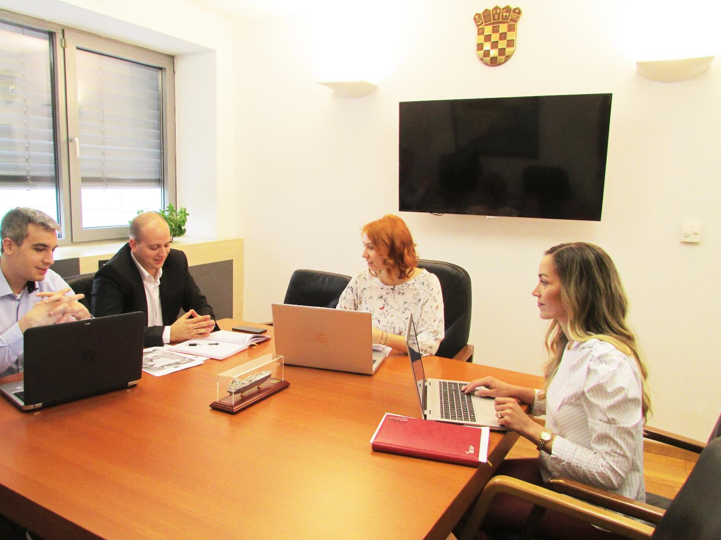
High level of professionalism in developing, managing and executing international scientific programmes

Slide 18











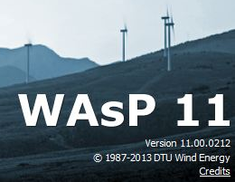


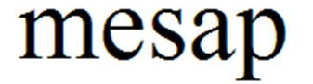








SOFTWARE
MESSAGE: Model for Energy Supply
Strategy Alternatives and their General
Environmental Impacts

Slide 19
MAIN PARTNERS/CLIENTS
> 200 partners around the world
  AEAI
  AECOM
  Agrokor d.d.
  Cities (Zagreb, Zadar…)
  Clinical Hospital Center (KBC Rebro Zagreb)
  Croatian Electric Company (HEP)
  Croatian Motorways
  District heating companies
  Energy Community Secretariat
  EPHZHB
  European Bank for Reconstruction and Development
  European Commission
  FAO
  Government of Republic of Croatia
  Government of Republic of Montenegro
  Government of the Republic of Bosnia and Herzegovina and Entities
  HEP Energy Service Company (HEP ESCO)
  HERA – Croatian Energy Regulatory Agency
  HOPS – Croatian Transmission System Operator
  HROTE – Croatian Energy Market Operator
  IAEA
  IEA
  INA – Oil Industry
  JANAF d.d. (Oil transport operator)
  KESH, Albania
  KfW Bankengruppe
  Končar d.d.
  KOSTT – Kosovo Transmission System Operator
  MEPSO – Macedoniana Transmission System Operator
  Mining Company Banovići, Bosnia-Herzegovina
  Ministry of economy of Republic of Croatia
  Ministry of infrastructure od Republic of Slovenia
  Ministry of regional developemnts on EU funds of Croatia
  NOS BiH – Transmission System Operator of BiH
  Numerous private companies and RES project developer
  Plinacro d.o.o. (Gas transmission operator)
  Privredna banka Zagreb d.d. (Member of Intes Sanpaolo Group)
  Regional Environmental Centre for Central and Eastern Europe
  T – HT d.d. (Member of Deutsche Telekom Group)
  UNDP
  UNIDO
  USAID
  USEA
  Utiliy services providers
  Zagrebačka banka d.d. (Member of Unicredit Group)
  World Bank

Slide 20
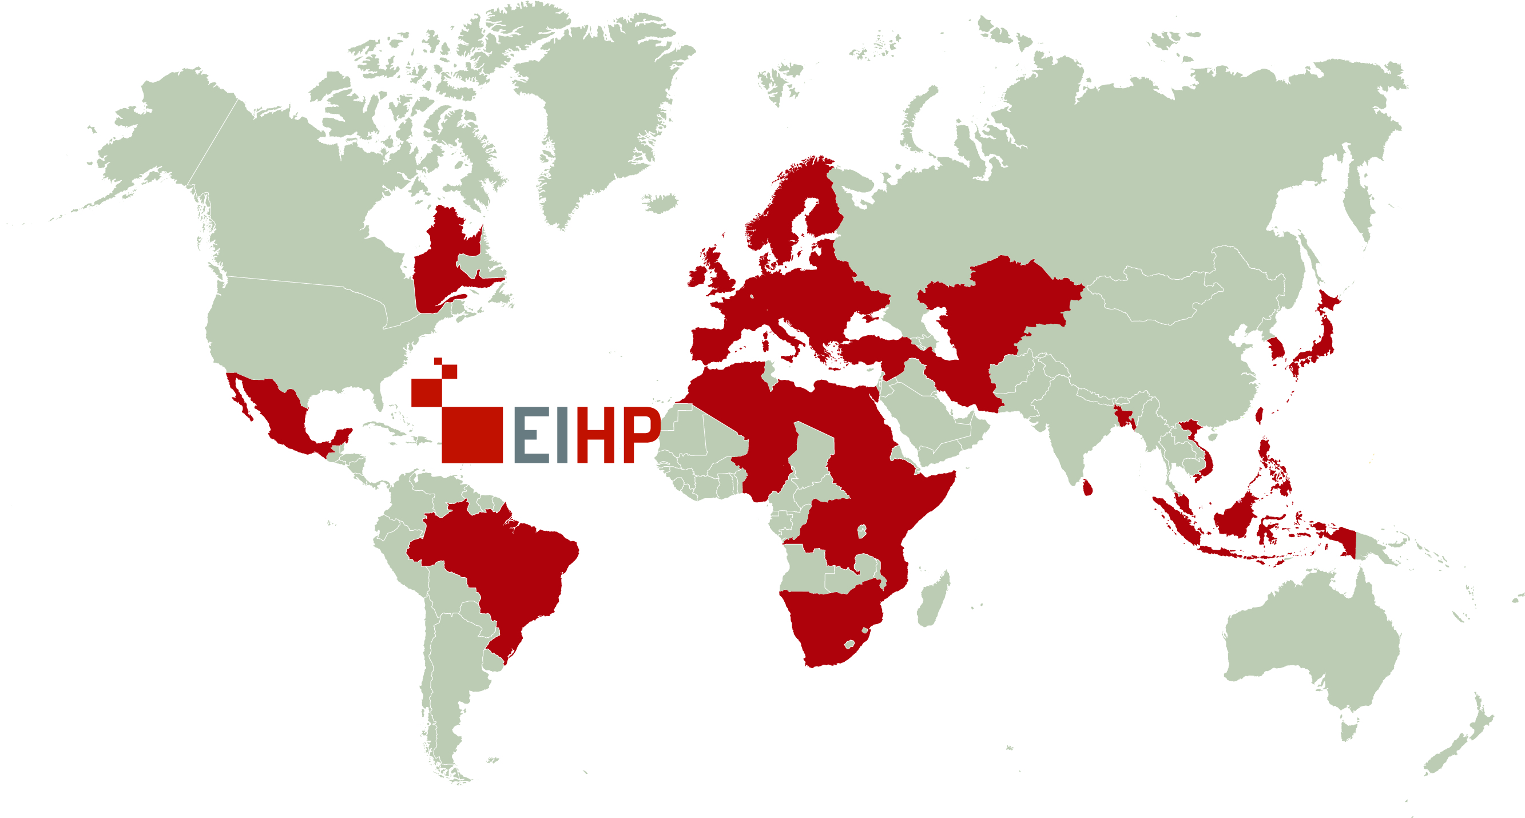
COUNTRIES EIHP WORKS IN:
> 50

Slide 21


Slide 22
